Slide 1
Data Gathering and Privacy Implications
Facebook tags
Enhanced 911 services
Rewards or loyalty programs
Body scanners
RFID tags
Implanted chips
OnStar
Automobile “black boxes”
Medical records
Digital video recorders
Cookies and flash cookies
1-1

Slide 2
Facebook Tags
Tag: Label identifying a person in a photo
Facebook allows users to tag people who are on their list of friends
About 100 million tags added per day in Facebook
Facebook uses facial recognition to suggest name of friend appearing in photo
Does this feature increase risk of improper tagging?
1-<number>

Slide 3
Enhanced 911 Services
Cell phone providers in United States required to track locations of active cell phones to within 100 meters
Allows emergency response teams to reach people in distress
What if this information is sold or shared?
1-<number>

Slide 4
Rewards or Loyalty Programs
Shoppers who belong to store’s rewards program can save money on many of their purchases
Computers use information about buying habits to provide personalized service
  ShopRite computerized shopping carts with pop-up ads
Do card users pay less, or do non-users get overcharged?
1-<number>

Slide 5
Body Scanners
Some department stores have 3-D body scanners
Computer can use this information to recommend clothes
Scans can also be used to produce custom-made clothing
1-<number>

Slide 6
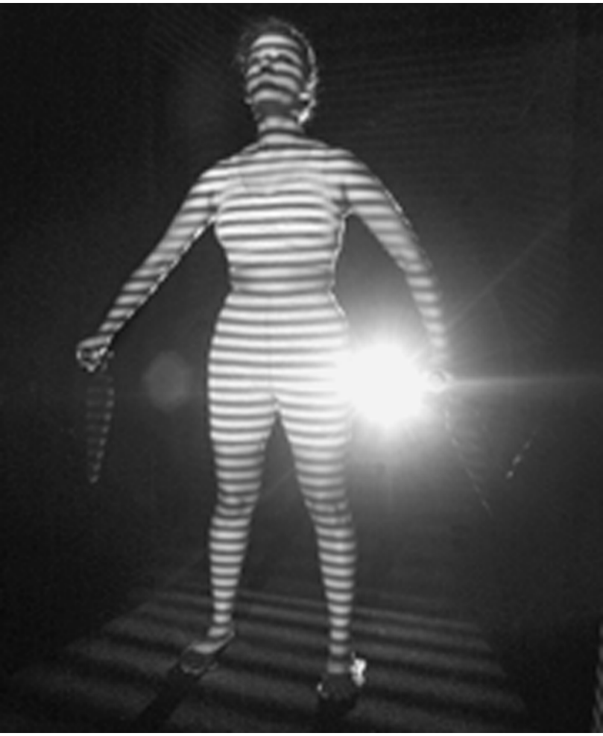
Body Scanner Takes Measurements
AP Photo/Richard Drew
1-<number>

Slide 7
RFID Tags
RFID: Radio frequency identification
An RFID tag is a tiny wireless transmitter
Manufacturers are replacing bar codes with RFID tags
  Contain more information
  Can be scanned more easily
If tag cannot be removed or disabled, it becomes a tracking device
1-<number>

Slide 8
Implanted Chips
Taiwan: Every domesticated dog must have an implanted microchip
  Size of a grain of rice; implanted into ear
  Chip contains name, address of owner
  Allows lost dogs to be returned to owners
RFID tags approved for use in humans
  Can be used to store medical information
  Can be used as a “debit card”
1-<number>

Slide 9
OnStar
OnStar manufactures communication system incorporated into rear-view mirror
Emergency, security, navigation, and diagnostics services provided subscribers
Two-way communication and GPS
Automatic communication when airbags deploy
Service center can even disable gas pedal
1-<number>

Slide 10
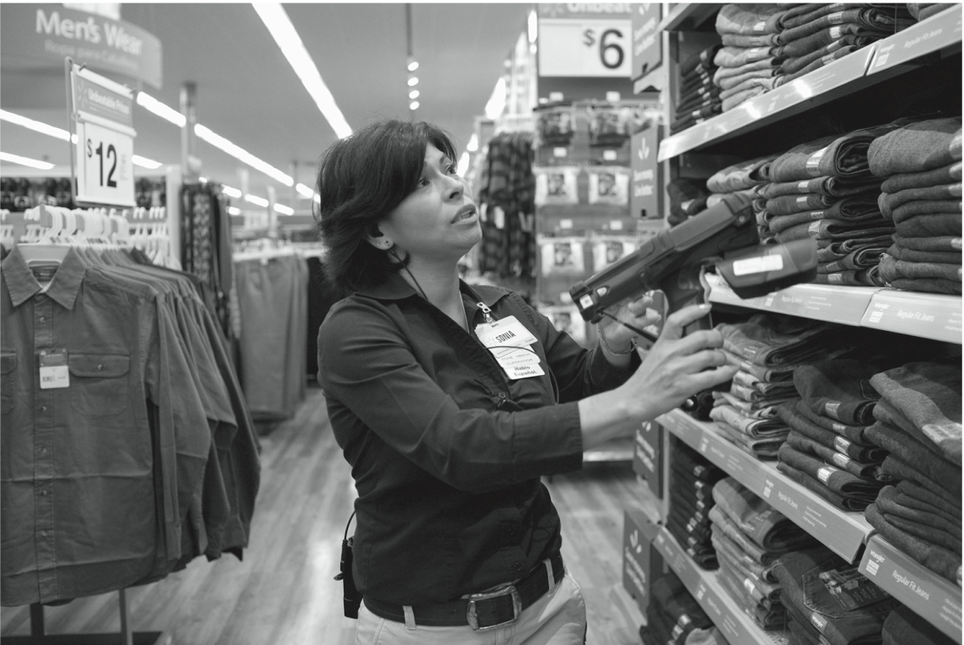
RFID Tags Speed Inventory Process
© Marc F. Henning / Alamy
1-<number>

Slide 11
Automobile “Black Boxes”
Modern automobiles come equipped with a “black box”
Maintains data for five seconds:
  Speed of car
  Amount of pressure being put on brake pedal
  Seat belt status
After an accident, investigators can retrieve and gather information from “black box”
1-<number>

Slide 12
Medical Records
Advantages of changing from paper-based to electronic medical records
Quicker and cheaper for information to be shared among caregivers
  Lower medical costs
  Improve quality of medical care
Once information in a database, more difficult to control how it is disseminated
1-<number>

Slide 13
Digital Video Recorders
TiVo service allows subscribers to record programs and watch them later
TiVo collects detailed information about viewing habits of its subscribers
Data collected second by second, making it valuable to advertisers and others interested in knowing viewing habits
1-<number>

Slide 14
Cookies
Cookie: File placed on computer’s hard drive by a Web server
Contains information about visits to a Web site
Allows Web sites to provide personalized services
Put on hard drive without user’s permission
You can set Web browser to alert you to new cookies or to block cookies entirely
1-<number>

Slide 15
Flash Cookies
Flash cookie: File placed on your computer’s hard drive by a Web server running the Adobe Flash Player
Flash cookie can hold 25 times as much information as a browser cookie
Flash cookies not controlled by browser’s privacy controls
Some Web sites use flash cookies as a way of backing up browser cookies. If you delete browser cookie, it can be “respawned” from the flash cookie
Half of 100 most popular Web sites use flash cookies
1-<number>

Slide 16
5.4 Data Mining
1-<number>

Slide 17
Data Mining Defined
Searching records in one or more databases, looking for patterns or relationships
Can be used to create profiles of individuals
Allows companies to build more personal relationships with customers
1-<number>

Slide 18
Google’s Personalized Search
Secondary use: Information collected for one purpose use for another purpose
Google keeps track of your search queries and Web pages you have visited
  It uses this information to infer your interests and determine which pages to return
  Example: “bass” could refer to fishing or music
Also used by retailers for direct marketing
1-<number>

Slide 19
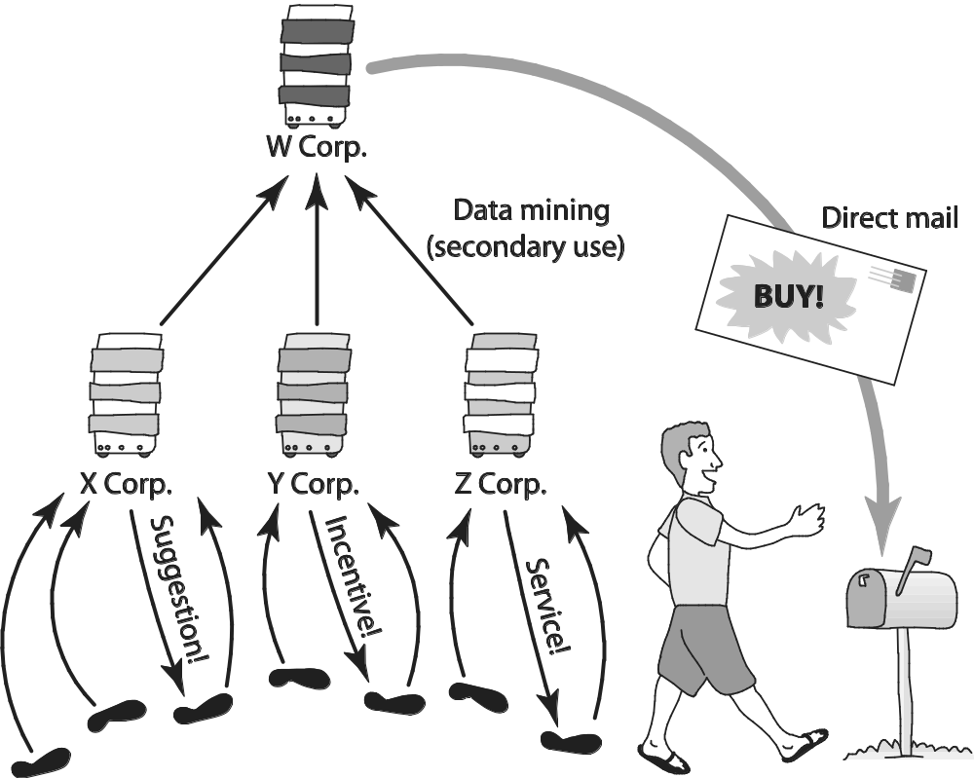
Secondary Uses of Information
1-<number>

Slide 20
Collaborative Filtering
Form of data mining
Analyze information about preferences of large number of people to predict what one person may prefer
  Explicit method: people rank preferences
  Implicit method: keep track of purchases
Used by online retailers and movie sites
1-<number>

Slide 21
Ownership of Transaction Information
Who controls transaction information?
  Buyer?
  Seller?
  Both?
Opt-in: Consumer must explicitly give permission before the organization can share info
Opt-out: Organization can share info until consumer explicitly forbid it
Opt-in is a barrier for new businesses, so direct marketing organizations prefer opt-out
1-<number>

Slide 22
Credit Reports
Example of how information about customers can itself become a commodity
Credit bureaus
  Keep track of an individual’s assets, debts, and history of paying bills and repaying loans
  Sell credit reports to banks, credit card companies, and other potential lenders
System gives you more choices in where to borrow money
Poor credit can hurt employment prospects
1-<number>

